Slide 1
Scraping Tokyo’s Scrappy venues:
Tokyo gig guide web scraping project
Alexander Sigman
NYCDSA
23 April 2019

Slide 2
More than (Hatsune) Miku: Tokyo’s diverse micro-genres
For the past several decades, tokyo’s musical landscape has been uniquE and heterogeneous, especially with respect to more “underground” genres (E.G., NOISE, FREE IMPROV, ELECTRO…)
Abundant “live Houses” of various sizes and aesthetic leanings

Slide 3
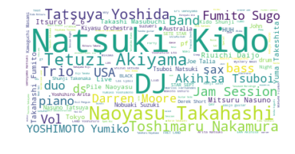
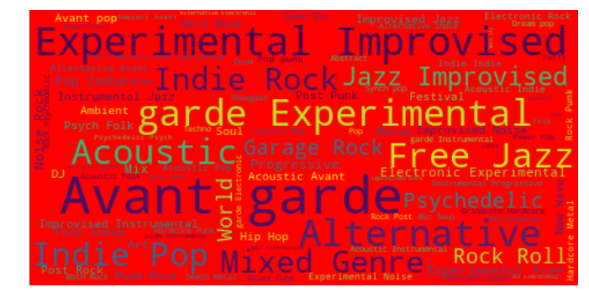
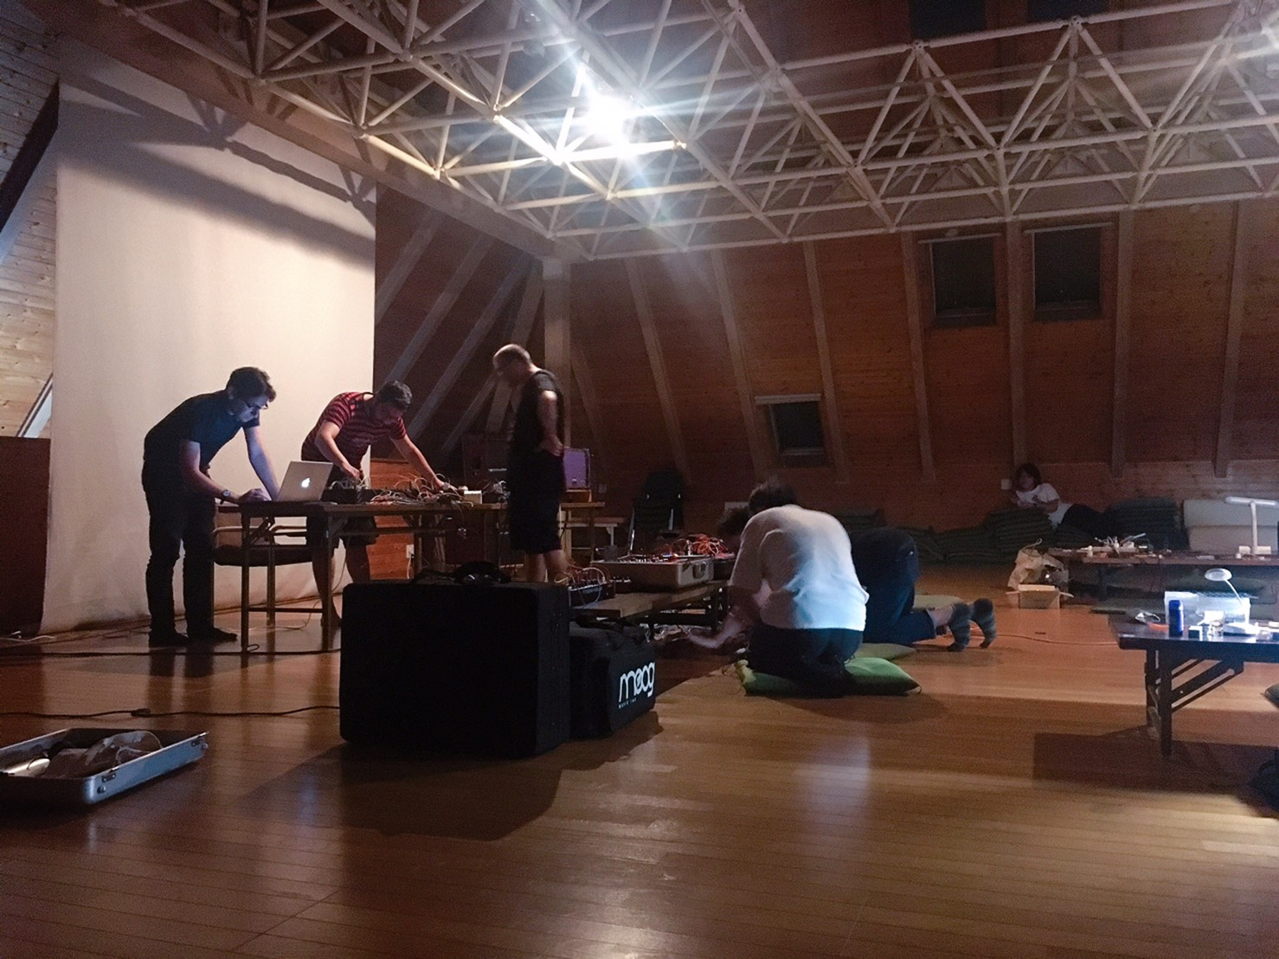
Tokyo area music scene(s)

Slide 4
Tokyo area is large…

Slide 5
…AND THE PUBLIC IS FRAGMENTED

Slide 6
Project motivation
GAIN A “BIRD’S EYE VIEW” ON THE TOKYO AREA MUSIC SCENE OVER THE PAST DECADE

Slide 7

Tokyo gig guide?
event listing site
Artists/venues/producers post events
Archive extends back to 2008
RANGES FROM MAJOR FESTIVALS TO TINY LIVE HOUSES/BARS
Ca. 21,000 events (and growing…)
709 venues, 203 areas, 89 genre categories
http://www.tokyogigguide.com/en/gigs/eventslist?task=archive

Slide 8
primary research questions
1. What have been the most popular tags (genre categories) in recent years, compared to a decade ago?

Slide 9
primary research questions
1. What have been the most popular tags (genre categories) in recent years, compared to a decade ago?
2. Which venues and neighborhoods of the Tokyo metro area have been the most active recently and historically?

Slide 10
primary research questions
1. What have been the most popular tags (genre categories) in recent years, compared to a decade ago?
2. Which venues and neighborhoods of the Tokyo metro area have been the most active recently and historically?
3. Which months are typically the densest with respect to number of events? In which year(s) have the greatest number of festivals been presented?

Slide 11
primary research questions
1. What have been the most popular tags (genre categories) in recent years, compared to a decade ago?
2. Which venues and neighborhoods of the Tokyo metro area have been the most active recently and historically?
3. Which months are typically the densest with respect to number of events? In which year(s) have the greatest number of festivals been presented?
4. Which neighborhoods, venues, and genres have featured the most expensive events? What have been typical price ranges for tickets?

Slide 12
EDA Pt. I: Genre Category

Slide 13
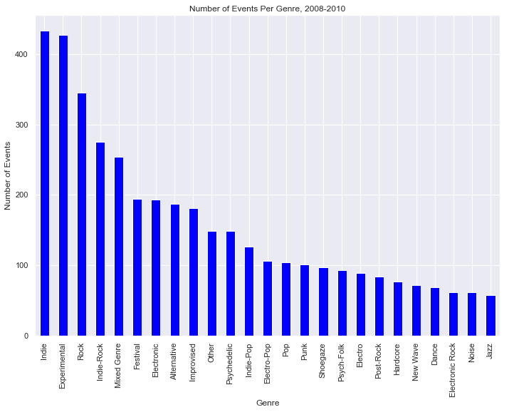
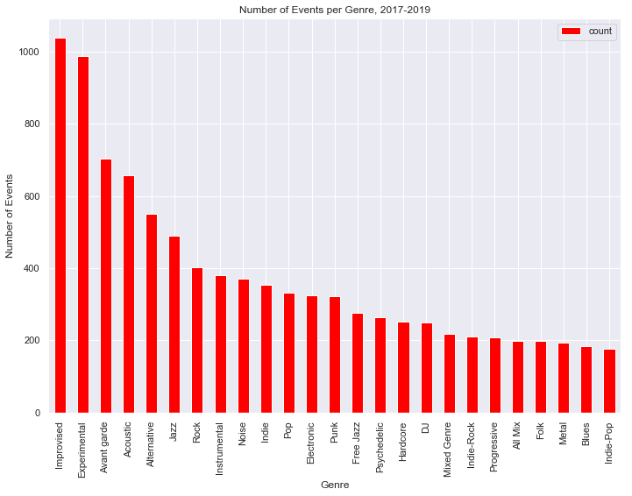
Most frequently used genre tags

Slide 14
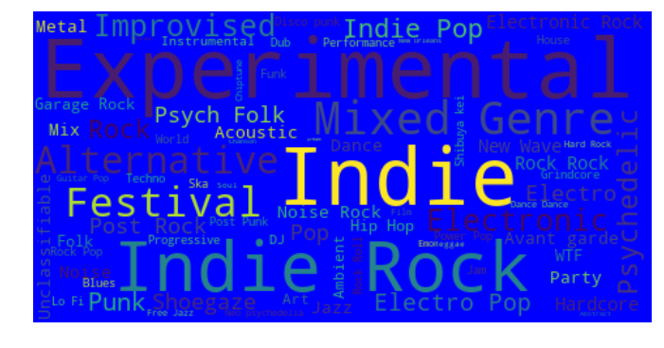
[word cloud representations]
2008-2010
2017-2019

Slide 15
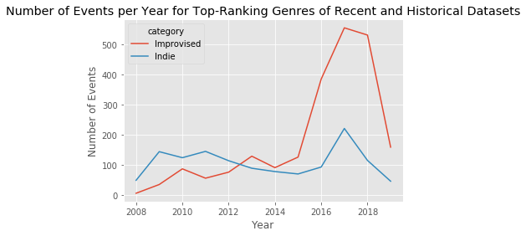
Indie/improvised “cross fade”

Slide 16
EDA Pt. II: AREA (NEIGHBORHOOD) AND VENUE

Slide 17
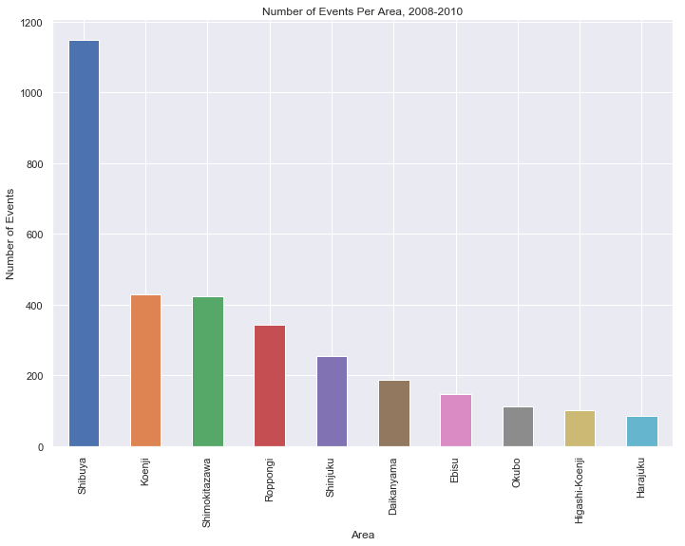
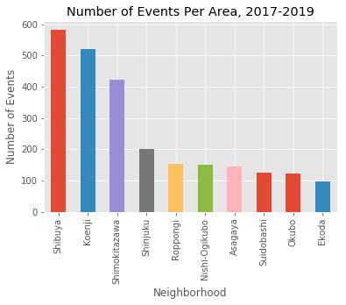
NUMBER OF EVENTS/AREA

Slide 18
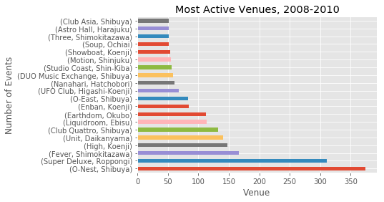
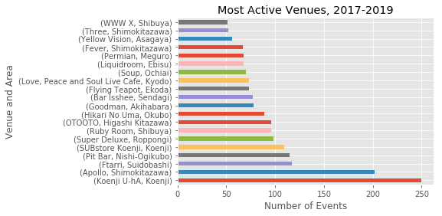
NUMBER OF EVENTS PER VENUE

Slide 19
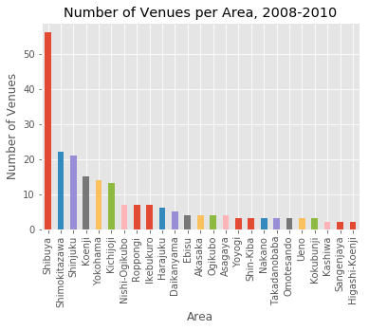
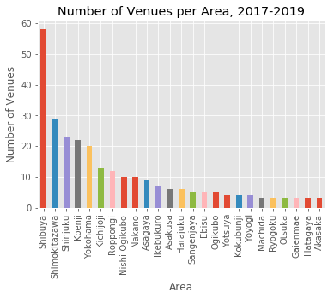
Number of venues per area

Slide 20
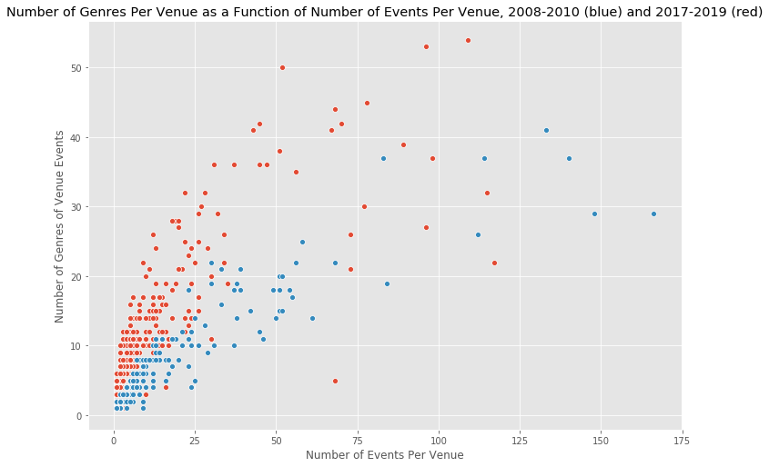
Number of events vs. genres per venue
Recent : r = 0.814
Old: r = 0.912

Slide 21
EDA Pt. 3: Time series analyses

Slide 22
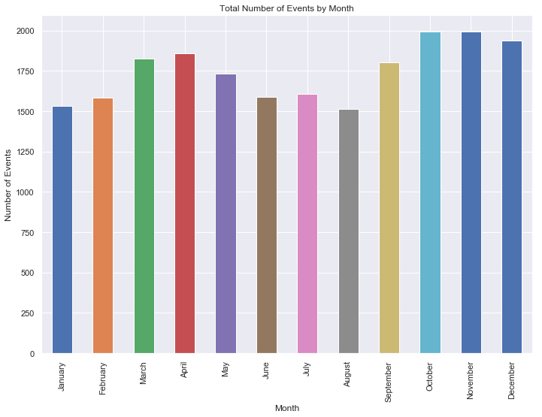
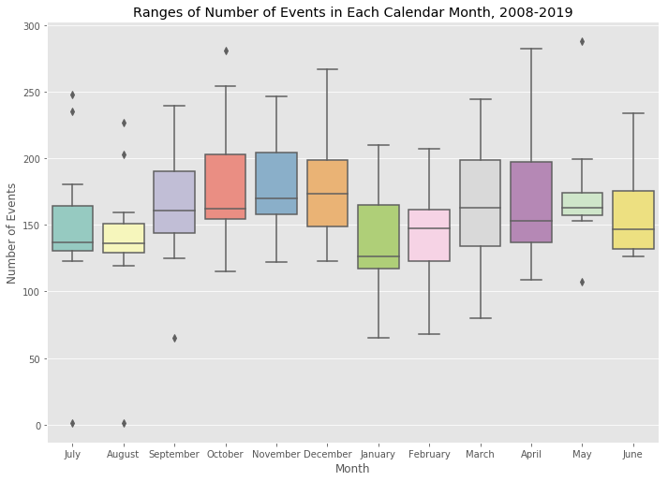
Number of events by month

Slide 23
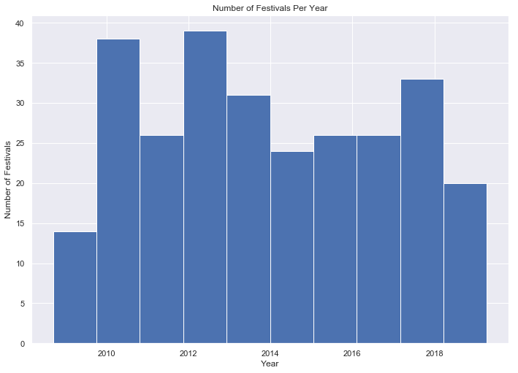
Number of Festivals per year

Slide 24
Eda Pt 4: ticket price analyses

Slide 25
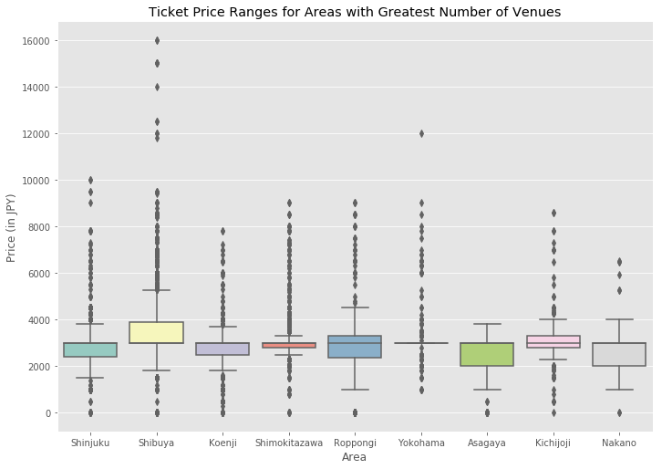
Ticket ranges by area

Slide 26
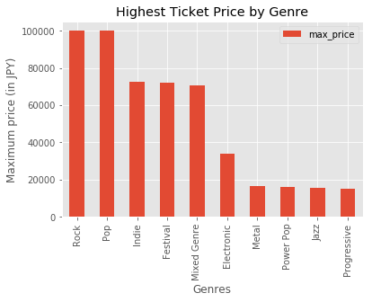
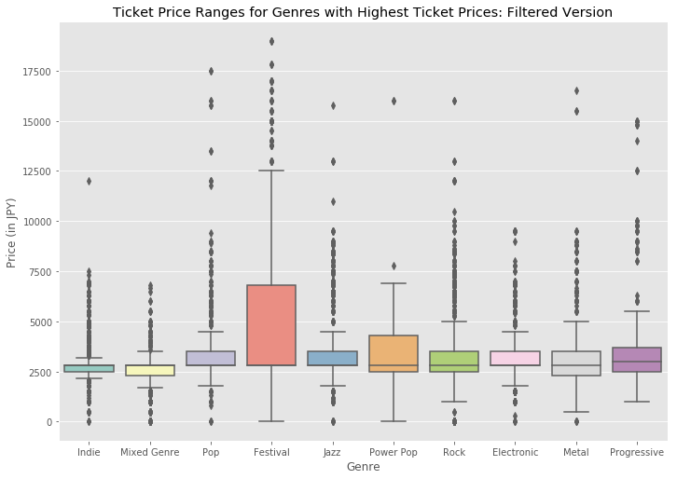
Most expensive genres

Slide 27
Conclusions:
1. genre tag DISTRIBUTIONS have shifted over the past decade. The most significant shift occuRred in 2012-2013, at which time the genre "Indie" declined in appearances, and "Improvised" increased.

Slide 28
Conclusions:
1. genre tag DISTRIBUTIONS have shifted over the past decade. The most significant shift occurred in 2012-2013, at which time the genre "Indie" declined in appearances, and "Improvised" increased.
2. There have been few changes with respect to most active areas (neighborhoods) in Tokyo...but the respective distributions of events per area and the most active venues in those areas are significantly different.

Slide 29
Conclusions:
1. genre tag DISTRIBUTIONS have shifted over the past decade. The most significant shift occurred in 2012-2013, at which time the genre "Indie" declined in appearances, and "Improvised" increased.
2. There have been few changes with respect to most active areas (neighborhoods) in Tokyo...but the respective distributions of events per area and the most active venues in those areas are significantly different.
3. October and November have been the most active months. However, based upon each month's IQR with respect to number of events, there are sizable differences from one year to the next. IQR's for May and August are the narrowest.

Slide 30
Conclusions:
1. genre tag DISTRIBUTIONS have shifted over the past decade. The most significant shift occurred in 2012-2013, at which time the genre "Indie" declined in appearances, and "Improvised" increased.
2. There have been few changes with respect to most active areas (neighborhoods) in Tokyo...but the respective distributions of events per area and the most active venues in those areas are significantly different.
3. October and November have been the most active months. However, based upon each month's IQR with respect to number of events, there are sizable differences from one year to the next. IQR's for May and August are the narrowest.
4. Ticket price seems to be more strongly correlated with genre than NEIGHBORHOOD...but ticket prices for several genres (including festivals) vary considerably.

Slide 31
FUTURE WORK:
1. INTEGRATE The Tokyo Gig Guide datasets with other event listing data

Slide 32
FUTURE WORK:
1. INTEGRATE The Tokyo Gig Guide datasets with other event listing data
2. PERFORM MORE RIGOROUS NLP ON EVENT TITLES

Slide 33
FUTURE WORK:
1. INTEGRATE The Tokyo Gig Guide datasets with other event listing data
2. PERFORM MORE RIGOROUS NLP ON EVENT TITLES
3. EXTEND DATE RANGE

Slide 34
FUTURE WORK:
1. INTEGRATE The Tokyo Gig Guide datasets with other event listing data
2. PERFORM MORE RIGOROUS NLP ON EVENT TITLES
3. EXTEND DATE RANGE
4. BETTER MAP VISUALIZATION SOLUTION! (E.G., LEAFLET)

Slide 35
FUTURE WORK:
1. INTEGRATE The Tokyo Gig Guide datasets with other event listing data
2. PERFORM MORE RIGOROUS NLP ON EVENT TITLES
3. EXTEND DATE RANGE
4. BETTER MAP VISUALIZATION SOLUTION! (E.G., LEAFLET)
5. CONSTRUCT CLASSIFIER TO PREDICT GENRE TAGS BASED UPON EVENT VARIABLES (E.G., VENUE, AREA, TITLE...)

Slide 36
Code :
https://github.com/atsigman/tokyo_gig_guide_web_scraping

Slide 37
Thanks!/ありがとう！
[Questions?]

